Slide 1
‘Meet the teacher’
Miss Grigulis

Slide 2
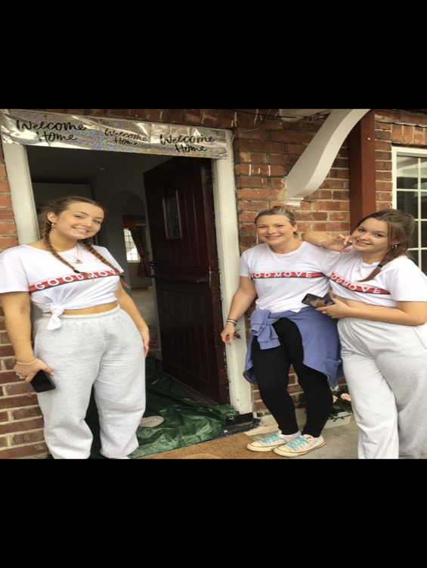
Introduction
Just a little bit about myself…
I have 2 girls. My eldest Ella works for British Airways.
My youngest Eva has just finished her A-levels and will be off travelling around the world from November.
Before becoming a teacher, I worked as a learning support assistant for five years working with children with special needs. This is my 6th year at Cheapside and I absolutely love teaching year 1.
I’m known for delivering the curriculum in a creative and engaging way and although we have new topics this year I will do everything I can to try and maintain my style of teaching through these.

Slide 3
Staffing
Mrs Jaine is our teaching assistant this year. Alongside, Mrs Bailey in the afternoons.
Forest school – Mrs Miles
PE – Mrs Higgins.

Slide 4
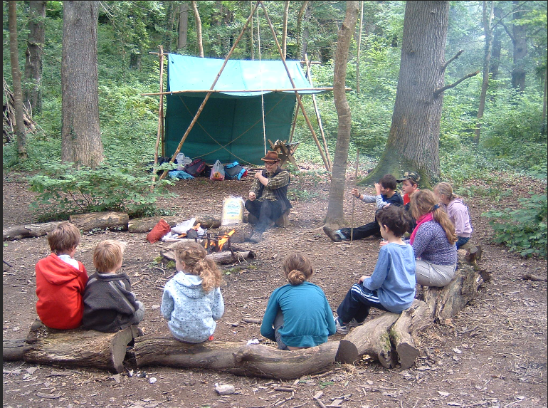
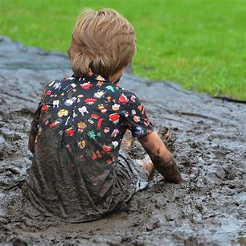
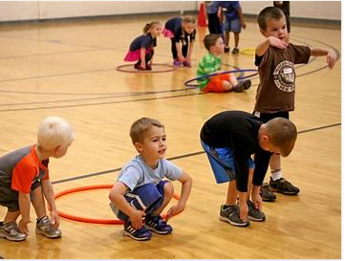
Information
FOREST SCHOOL – Thursday afternoons -
A pair of warm tracksuit bottoms or leggings, navy blue or black. The school PE tracksuit bottoms are ideal for this.
· The school PE jumper or zip up hoodie
· The school PE Tee-shirt
· A waterproof coat and waterproof trousers
· A pair of trainers and (a pair of wellington boots that will be kept in school.)
· Warm socks, gloves and a hat as the weather gets colder
PE – On a Tuesday Morning -
Children to come in to school dressed in their PE kit. PLEASE make sure it is named.

Slide 5
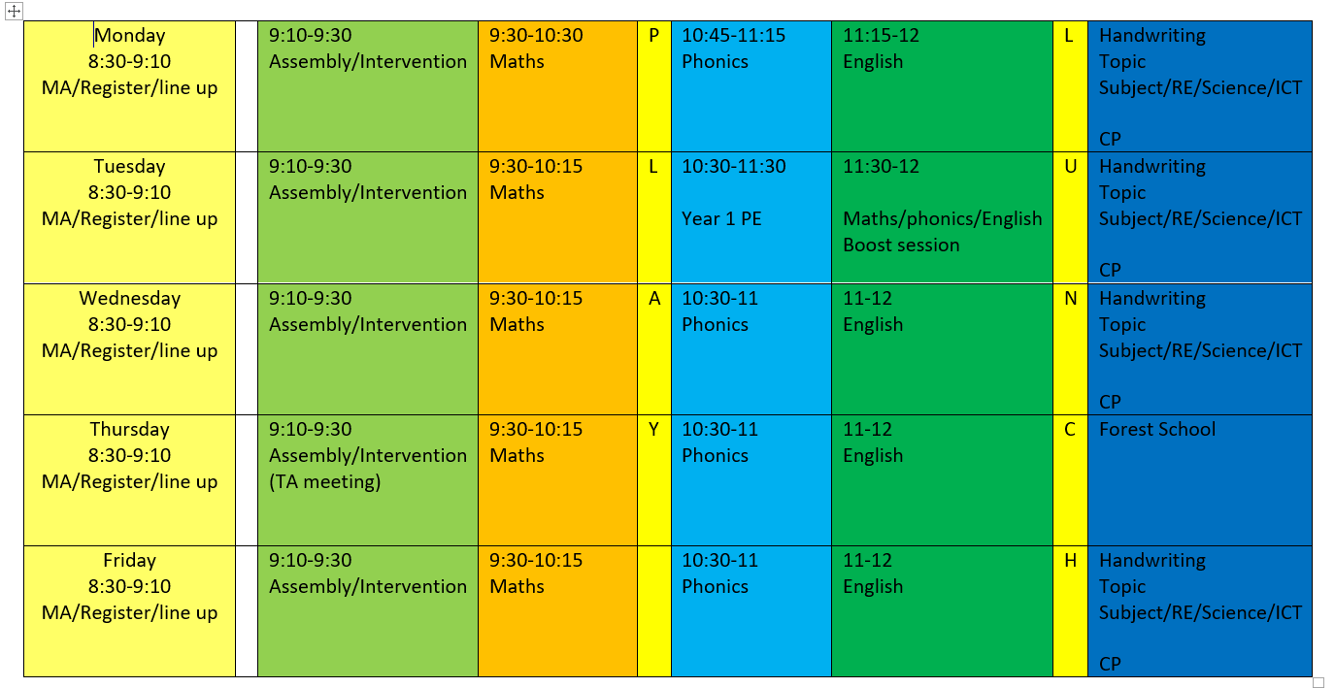

Slide 6
Home work
Common Exception words – Half-termly test of review words. The list to learn will be under homework on the class pages.
Please read with you child every day. We will be sending out reading records and we can then track and read your comments. Books to be read three times and then returned.

Slide 7
Home Learning Grids:
All children receive a grid which offers a range of learning activities each half term. These activities provide the opportunity for the children to extend their understanding and respond creatively, giving greater ownership of their learning.
Ideally, children can submit a piece each week.
Activities are designed to complement the learning that children will be doing in class, as well as give opportunities for children to further their learning and engage parents with what they have been learning in school. Start date for home learning will be the 29th September 2025 with first submission on the 6th October 2025.
In addition to the half-termly Home Learning Grid:
All children are expected to read every day.
From Summer Term in Year 1, children are also given Timetables Rock Stars or Numbots log in to practise their multiplication facts and weekly spellings.

Slide 8
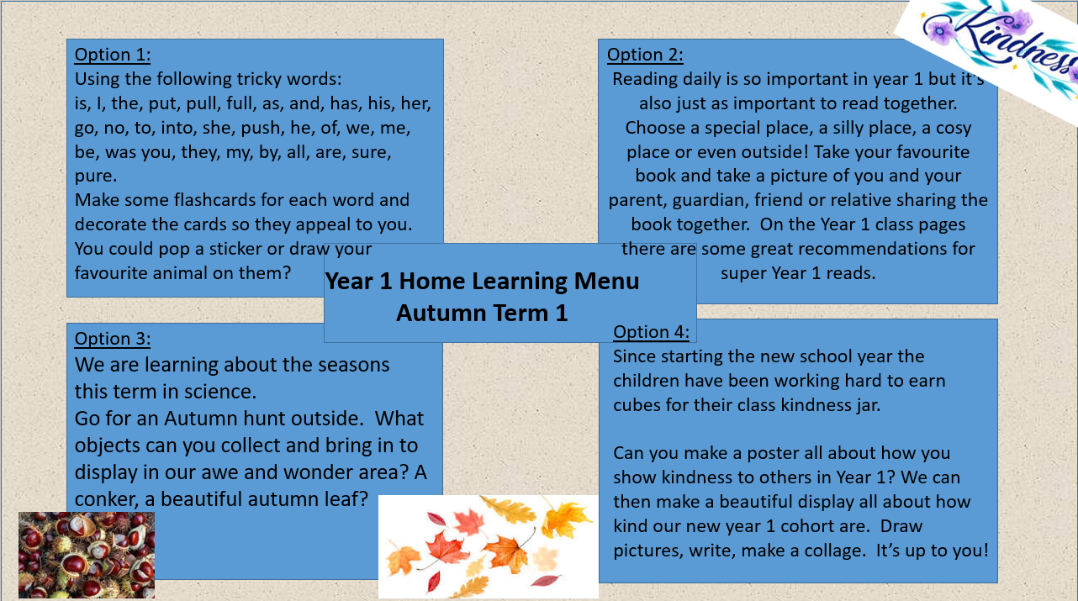

Slide 9
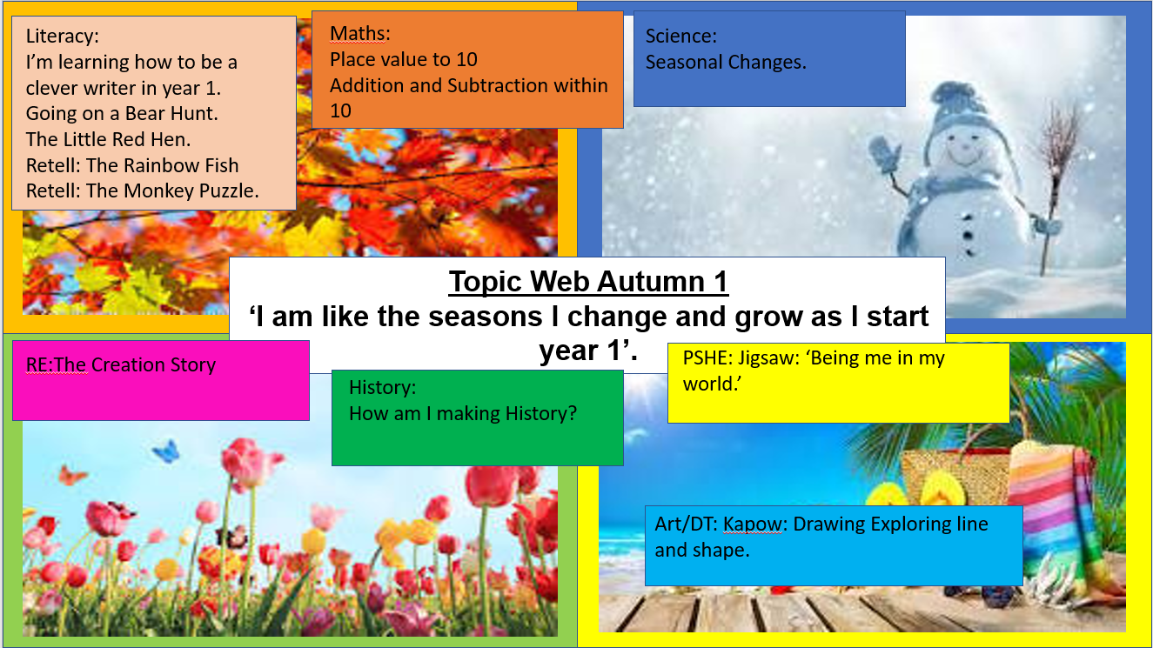

Slide 10

Reading
Please can you make sure your child brings their reading book in to school every day as we like to hear every child read individually once a week when we can. Please can the books be put into a zip lock plastic bag and put into the purple reading box. The box will be by the door.
Just to reassure you I will move them onto the next stage when they are ready.

Slide 11
General
There is fruit available for the children at snack time. If your child does not like fruit please provide and alternative savoury snack.
Please do remember to send a water bottle in each day.

Slide 12
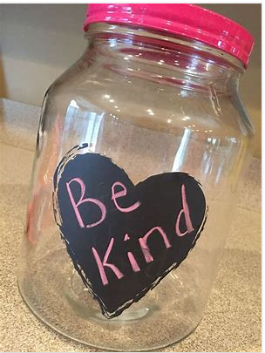
Finally…
Please feel free to communicate anything you feel we need to know that might be important. Especially if you feel your child might need extra emotional support that day for whatever reason and as long as we are aware we can adapt the day for them. I know and understand the challenges of being a parent and am also here for you if you ever need any support or a listening ear. Please email me via the office to arrange an appointment.
My core value as a teacher is nurture and therefore I set precedents to this as a foundation to good learning. My class rule is ‘kindness’ and the children have already spent the last week learning how to be ‘kind’ when they play and learn. I will often weave their learning on kindness through the schools values.
We have a class ‘kindness jar’ and the children are rewarded at the end of each week for filling this jar with acts of kindness. We then celebrate their acts of kindness with ‘celebration Friday’. Please remind your children of our class rules. We incorporate these daily into our class routines. Kind hands! Kind feet! Kind words! And Kind Thoughts!
Notes:
. I work a lot with the childre.n on emotional literacy and especially because of the challenges that have been posed due to the time the children have had away from each other and school I put a lot of emphasis in my class on teaching positive social and communication skills. We do a lot of work on sharing, learning to play and listening to learn.

