Slide 1
Spring 1 Topic Web
All about toys!

Slide 2
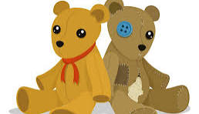

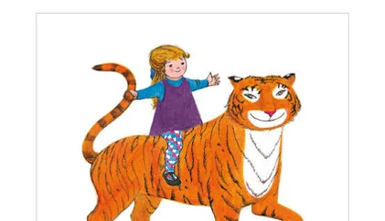

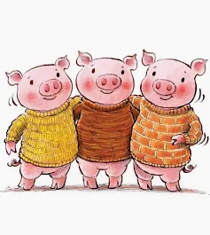
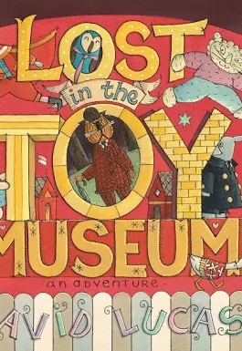

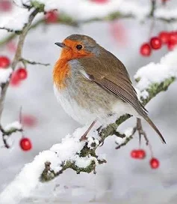
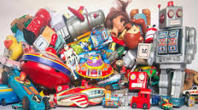
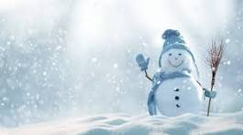

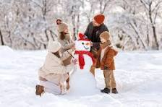
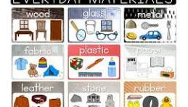
English:
The Robin.
The tiger who came to tea.
Lost Toy Museum.
The 3 little pigs. Dogger.
Phonics:
Phase 5 sounds and Grow the code.
Alternative sounds.
Phase 5 tricky words.
RE:
Theme: Jesus as a friend.
Enquiry: Was it always easy for Jesus to show friendship?
Science:
The season of Winter Everyday Materials
‘All about Toys..’
Design and technology:
Mechanisms: Wheels and axles.
Design and make a pull along toy.
History:
How have Toys changed?
Maths:
Addition and subtraction within 10.
Place value to 20.
Handwriting:
i,l,t a,g,q f,j
h,b,p e,s x,z
r,n,m u,y
C,o,a,d v,w,k revisit all capital letters.

