Slide 1
New home learning grid for Spring 1
Year 1

Slide 2



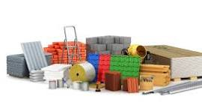

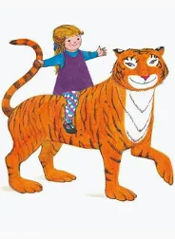
Tiger who came to Tea:
Please access the word document below the home learning grid on class pages.
Material Detectives:
Please access the word document below the home learning grid on class pages.
Toy Time Travellers:
Please access the word document below the home learning grid on class pages.
Year 1 Spring 1 Home Learning Grid
Reading
Please continue reading with your child daily and make sure you sign their reading record. Every three read signature will move your child further up the reading tree. Please could you ask your child to make a name label and decorate it with all their favourite characters from their favourite books. This will be used for the reading tree journey.

