Slide 1
Spring 2 Topic web
Year 1 – Comparing Animals

Slide 2
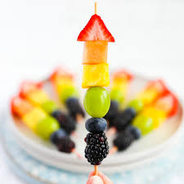
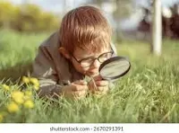
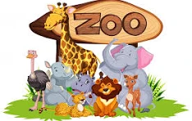
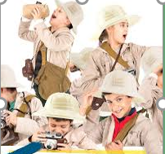
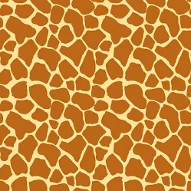
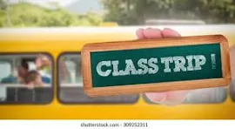
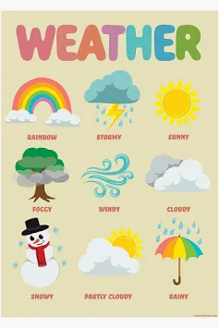

The Animal Explorers!
Handa’s Surprise – Africa Topic week 23rd-27th February 2026 – African Silohuettes, African geography, Massai necklaces, design you own fruit kebabs!
English: handwriting – I fill the line with my handwriting now.
The Hare and the Tortoise – Consolodation
Six Dinner Sid – capital letter for names of places and days of the week.
Hairy Maclary – Consolidation.
Riddles-Linked to Pets – use new sentence openers.
Riddles-Exotic Animal
Recount- Jane Goddall
Phonics:
Year 1 Spring 2 Topic Web: Comparing Animals.
Science:
Comparing Animals:
Animal Groups
Describing Animals
Comparing Animals
Carnivore/Herbivore/Omnivore
Pets
Jane Goodall
Geography:
Where is the UK?
What are the four seasons?
What are the compass directions?
What is the weather like today? Is the weather the same everywhere in the UK?
Maths:
Geometry
Place Value within 20
Addition and Subtraction within 20

Slide 3
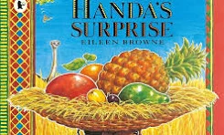
The Animal Explorers! Home work Grid.
Handa’s Surprise:
See attached menu choice for activites – choosing either 1,2 or 3. Enjoy!
Science: Comparing Animals – Activity Table choose an activity to complete from the grid. See attached to class pages.
Year 1 Spring 2 Topic Web: Comparing Animals.
Geography:
What is the weather like?
Please can you make a weather chart and record the weather for a week. Please record using weather symbols. If you like you could also see if you can record the temperature each day?
Watch a weather report with your child and see if they can role play their days weather observation like the presenters on TV.
Maths – Place Value to 20 –
Fun learning games. See attached word document to class pages giving you a number of game ideas to play with your child at home.
If your child is confident with PV to 20 go to 50 even try 100. Have fun!

