Slide 1
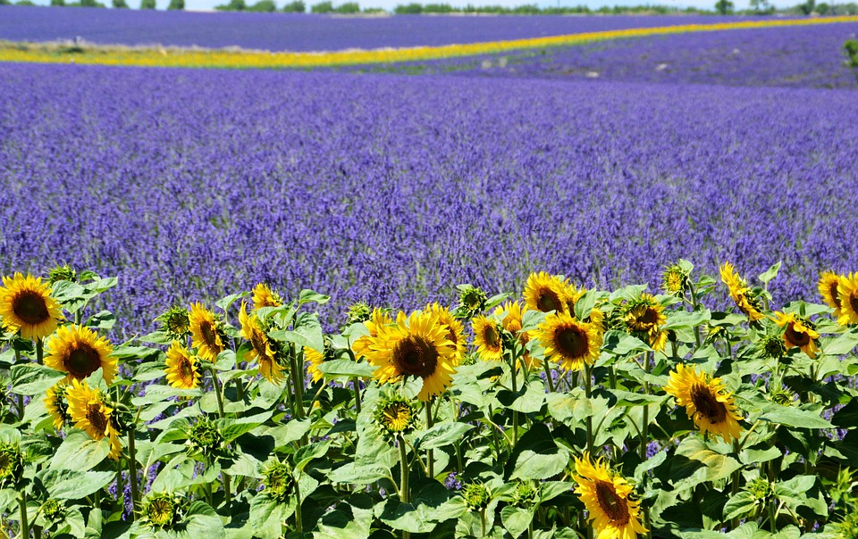
HISTORY:
.How did we learn to fly?
ENGLISH:
.Emma-Janes aeroplane
.The cloud spotter
.The koala who could
.Fly High!
.Amelia Earhart
.The way back home
Skills: Time adverbials. Conjunctions Description and character setting. Diary writing, using commas in lists
MATHS:
.Capacity and temperature
.Fractions
.Time
PSHE:
.Zones of regulation and self esteem
SUMMER 1 - HISTORY
Topic: How did we learn to fly?
MUSIC:
.Pitch
COMPUTING: .Effective searching
.Creating pictures
SCIENCE:
.Plant growth
RE:
Does going to a mosque give Muslims a sense of belonging?
PE:
Games-Cricket

