Slide 1
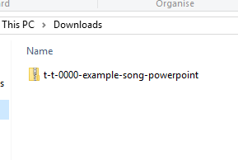
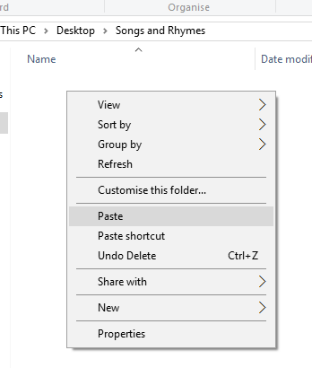


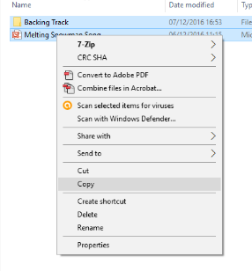
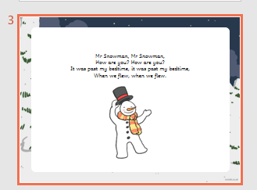
Guidance for Video/Audio in PowerPoints
1. Open the folder and copy all the files.
2. Paste the copied files into a new folder.
3. Open the PowerPoint file, enable editing and enter presentation mode (start the slide show).
Please note the embedded audio may not be compatible with early versions of PowerPoint.
You may wish to delete this slide before beginning the presentation.

Slide 3


blanc

Slide 4

marron

Slide 5

noir

Slide 6

orange

Slide 7

gris

Slide 8

bleu

Slide 9

violet

Slide 10

rouge

Slide 11

vert

Slide 12

rose

Slide 13

jaune

